Slide 1
Predicting Sportswear Demand in UK Cities

Slide 2
The prediction of the sportswear demand is an important part of a market analysis for sportswear stores
Specialized sportswear stores need an in-depth knowledge of certain sports in order to provide the best products and advise to customers
A lot of time and effort is spent on training staff and finding the best suppliers
Knowledge on the sports practiced in cities allows the selection of the best cities to open new stores in

Slide 3
Web Scraping and Data Wrangling
The 25 most populous cities in the UK were obtained from https://www.thegeographist.com/uk-cities-population-1000/
The latitude and longitude of each city was obtained using the Python client geopy
The sport venues in each city were obtained using the location technology platform Foursquare (https://foursquare.com/)

Slide 4
K-means algorithm
The k-means algorithm is an unsupervised clustering algorithm
It is suitable to cluster objects (cities in this project) that are similar to each other
As a discriminating feature, the ten most common sports venues within the cities were chosen

Slide 5
Results

Slide 6
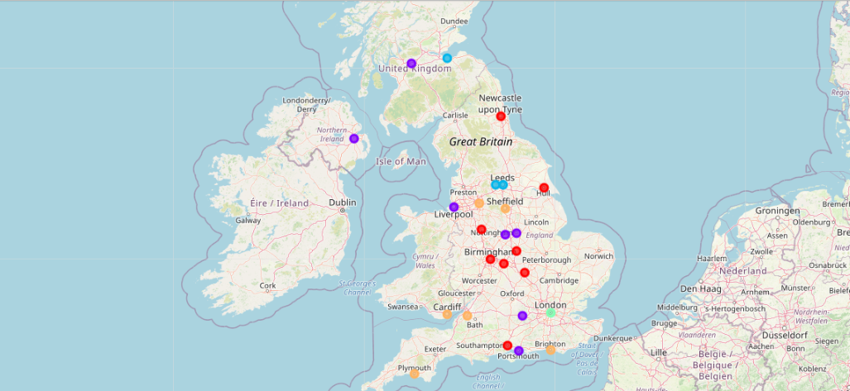
Result of clustering
Map of the UK with the 25 most populous cities superimposed on top. The different colours represent different clusters

Slide 7
Clusters
Birmingham, Leicester, Coventry, Belfast, Kingston Upon Hull, Newcastle upon Tyne, Stoke on Trent, Southampton, and Northampton
Sheffield, Leeds, Edinburg, and Bradford
London
Liverpool, Cardiff, Plymouth, and Reading
Glasgow, Bristol, Manchester, Nottingham, Derby, Portsmouth, and Brighton

Slide 8
Conclusions
The clusters obtained can be used as a first step for sport shop owners to chose in which cities to expand
Shop owner should then make further considerations to choose in which of the cities to open, e.g., Business connections, rent prices, and competition
Further clustering can be run to determine the best area within the selected cities to open the shop

